Slide 1
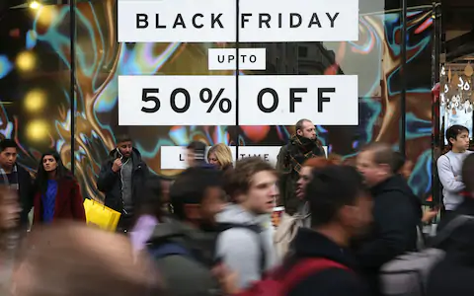
Group-2
Black Friday customer purchase behavior against different products
Team Details:
Rithesh Chaudhury
Madasu Leena
Sowmya Madabushi
Abdul Shaik Khaleel
Karthikeyan Thallam
Project Mentor:
Dr. Dipanjan Goswami

Slide 2
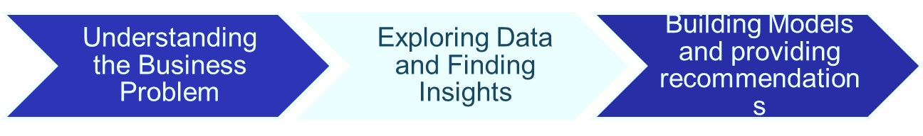
Problem Statement
In this project we are dealing with Black Friday dataset. The dataset here is a sample of the transactions made in a retail store during the Black Friday month.
The scope of the project is to study the customer behavior on purchase.
STEPS TAKEN:

Slide 3
Data Description
The total number of rows are 5,37,577. Below are the variables in the dataset:
Variable | Definition
User_ID | User ID
Product_ID | Product ID
Gender | Sex of User
Age | Age in bins
Occupation | Occupation (Masked)
City_Category | Category of the City (A,B,C)
Stay_In_Current_City_Years | Number of years stay in current city
Marital_Status | Marital Status
Product_Category_1 | Product Category (Masked)
Product_Category_2 | Product may belongs to other category also (Masked)
Product_Category_3 | Product may belongs to other category also (Masked)
Purchase | Purchase Amount (Target Variable)

Slide 4
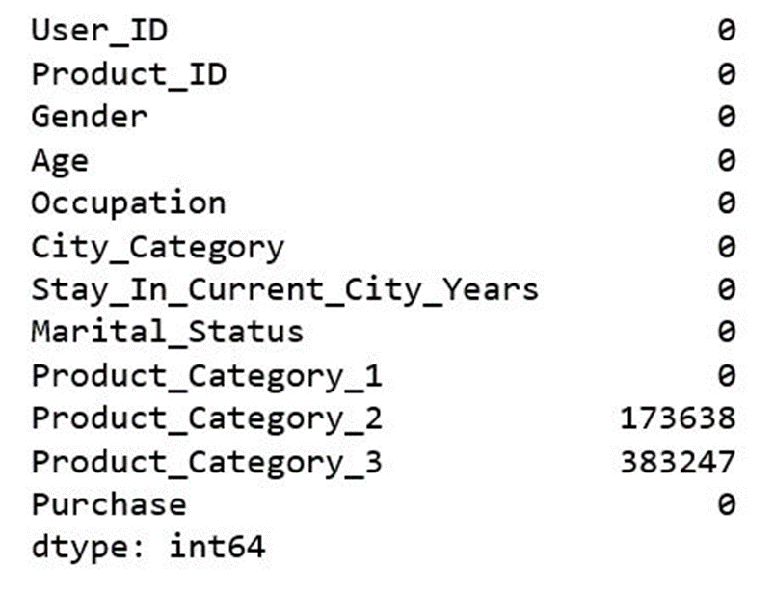
Data Cleaning
Null-value Treatment:
Null values in product category are due to the fact that customers did not buy from that sub-categories and hence it is null.
Here we are imputing the null values with 0 because Product_Category_2, Product_Category_3 are dependent on Product_Category_1.
Outlier Treatment:
Outliers in the data are present in purchase column.
The outliers from the data are not removed as their removal might affect the sales data

Slide 5
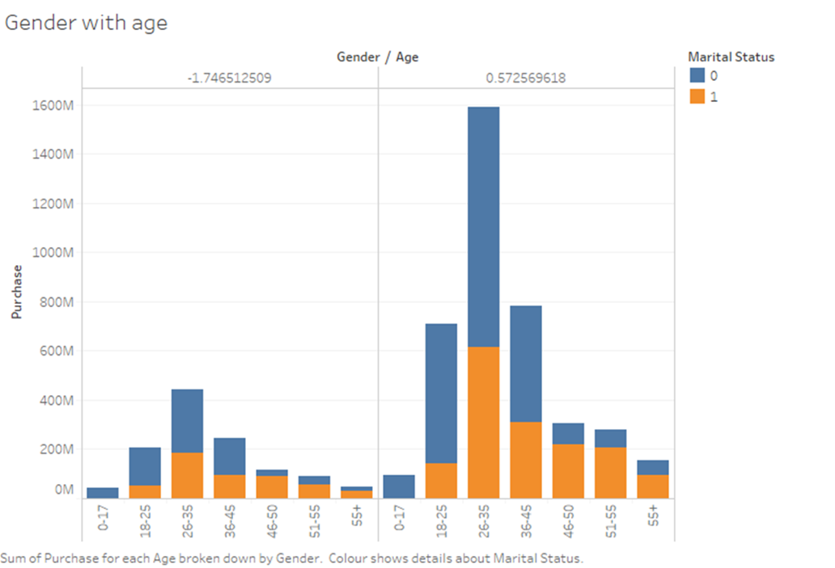
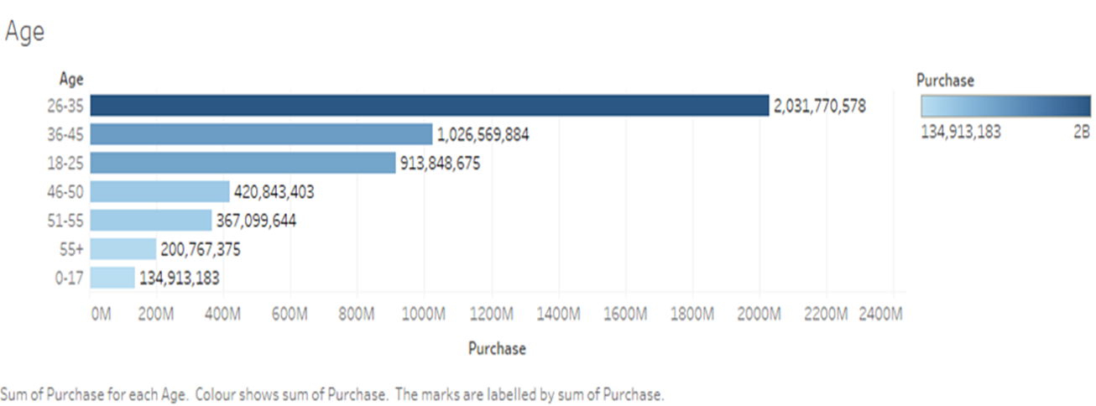
Exploratory Data Analysis
Here we can clearly see that men aged between 26-35 are going with highest purchase.
People aged between 26-35 have made highest purchases whereas teenagers (0-17) have made the least purchases.

Slide 6
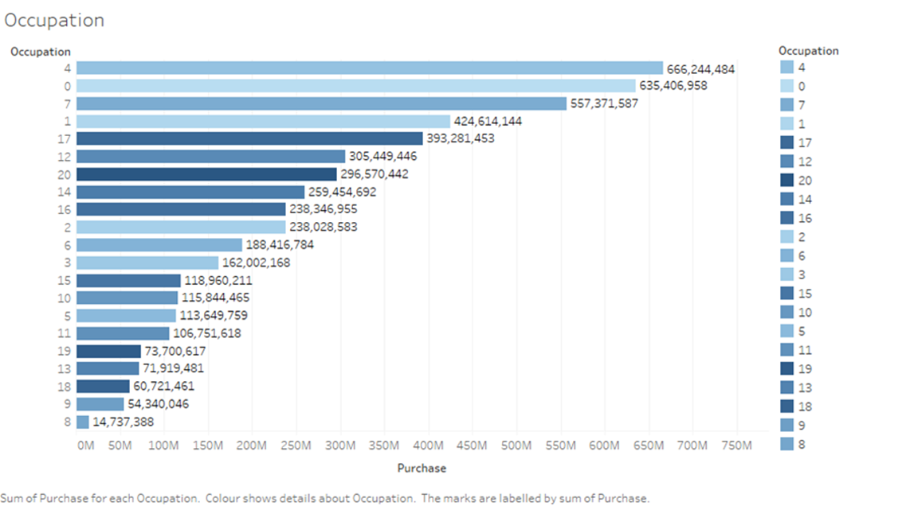
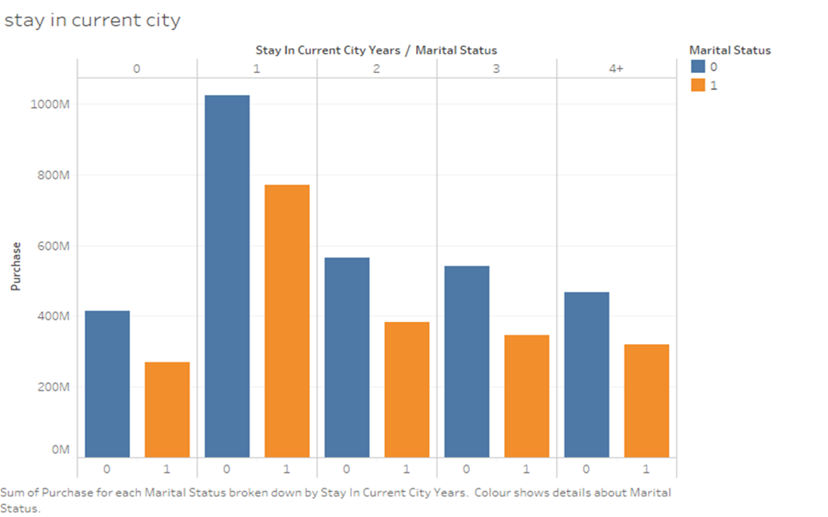
This graph depicts the purchases made basis on the occupation. As we can see, people with occupation 4 have made higher purchases.
Purchases for each marital status which is broken down by stay in current city years where customers who stayed only for 1 year and who are unmarried do higher purchases

Slide 7
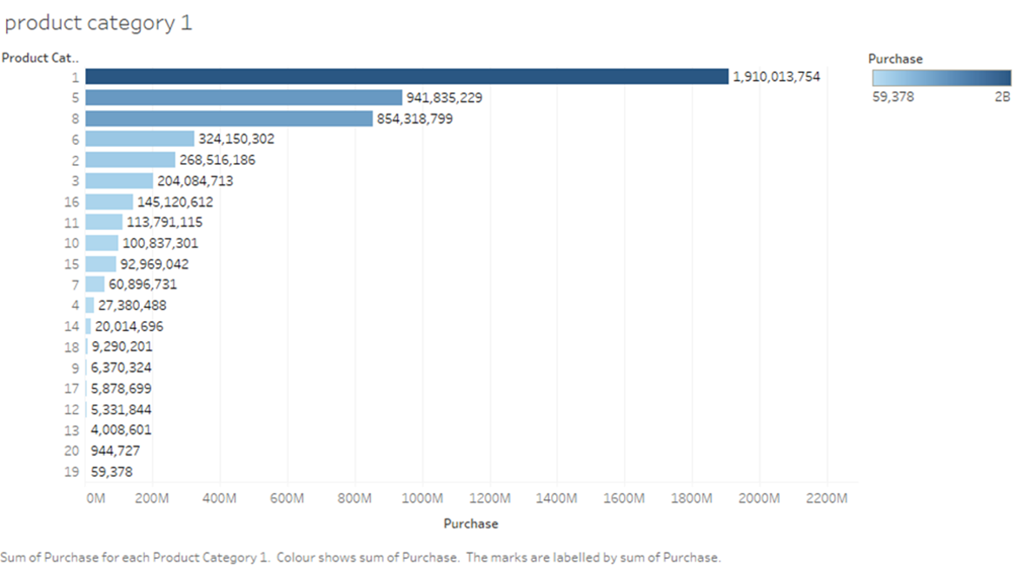
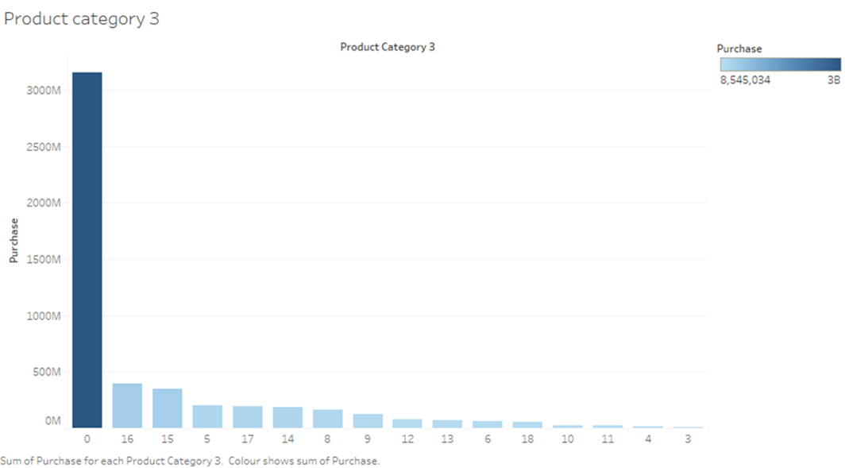
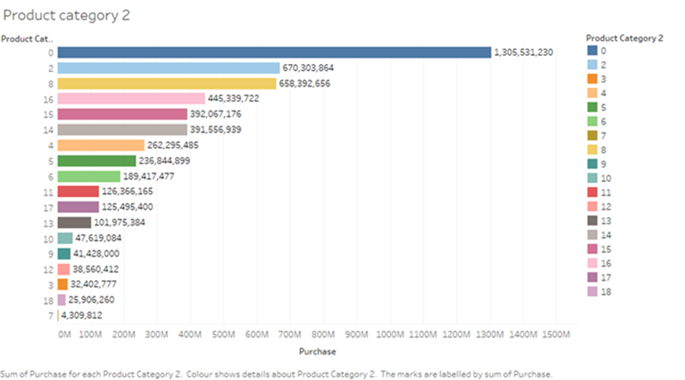
Product Category 1: Here category-1 has been bought highest.
Product Category 2: The highest purchase is for category 2 as 0 is ignorable as we imputed it.
Product Category 3: The maximum purchase is for 0 but we take category 16 which is very less compared to Product_category_1 and Product_Category_2.

Slide 8
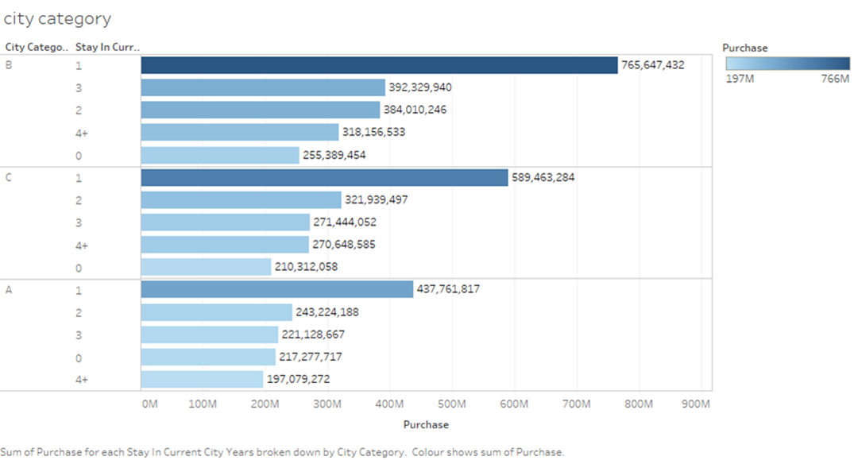
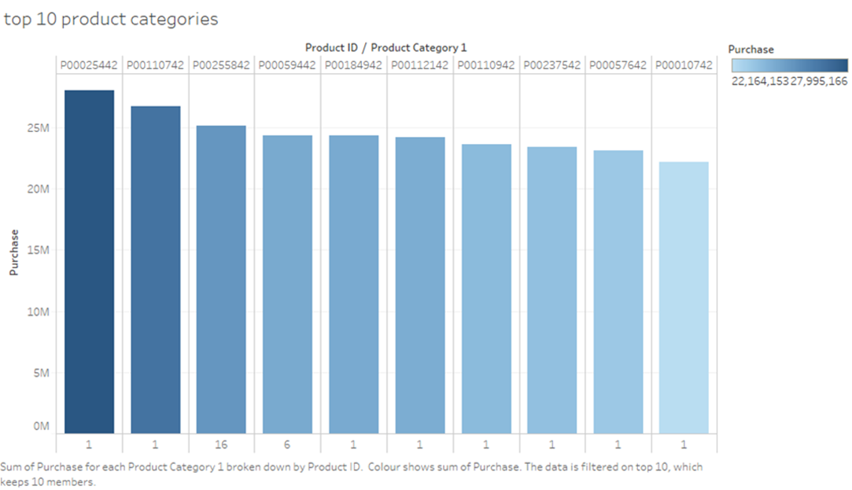
Here we can see the sum of purchases for each stay in current city years which is broken down by city category where City Category B and staying for 1 year in a city purchase rate is more.
Top 10 categories which shows top 10 customers product IDs

Slide 9
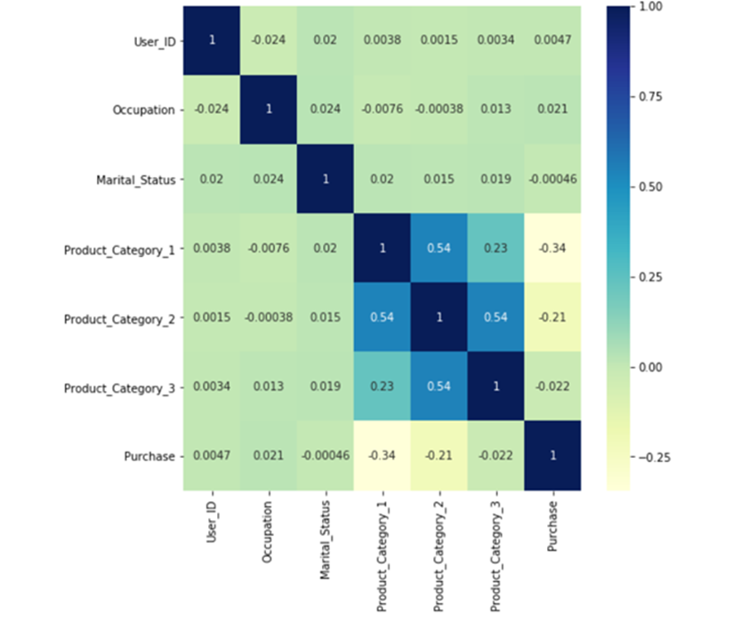
Correlation Matrix
We can see the correlation between the features is very less.
Maximum co-relation is between Product_category_1 and Product_category_2 which is also significantly less.
Hence, we are building our base model by clustering.

Slide 10
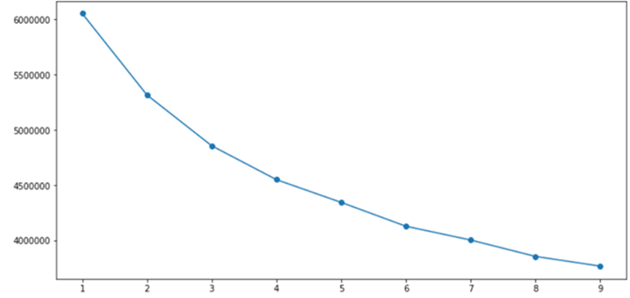
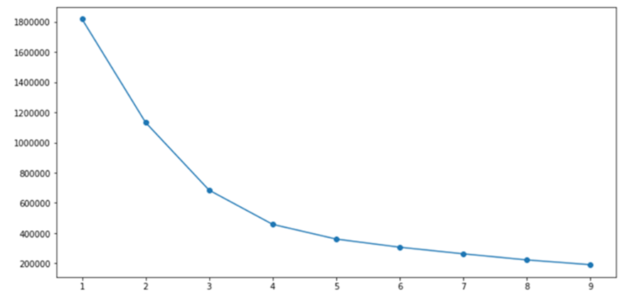
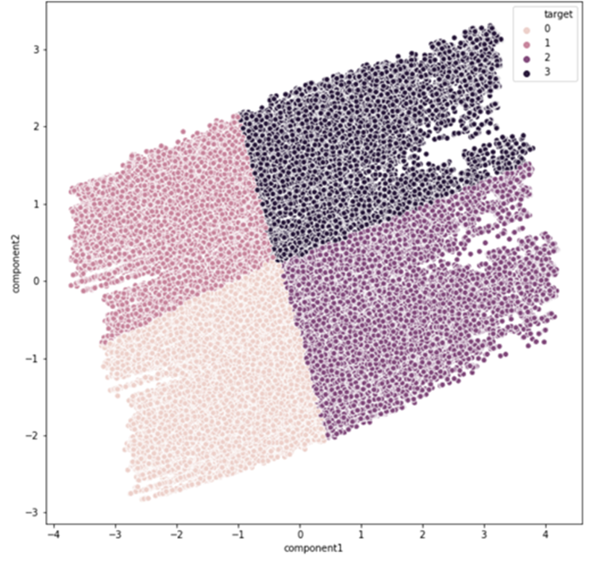
Base Model
K means without PCA
K means with PCA
In the given dataset, as the variables are not correlated, we have done clustering.
From the elbow plot, the observed is k=4.
We can see that whole data is clustered into 4 clusters. But the clusters were not unique and we cannot infer much.

Slide 11
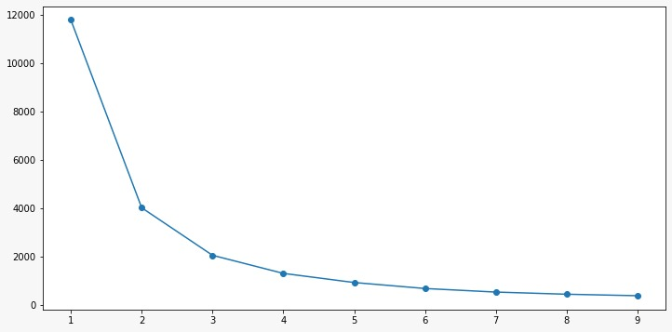
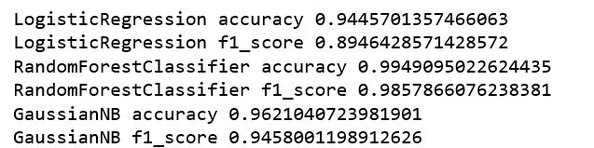
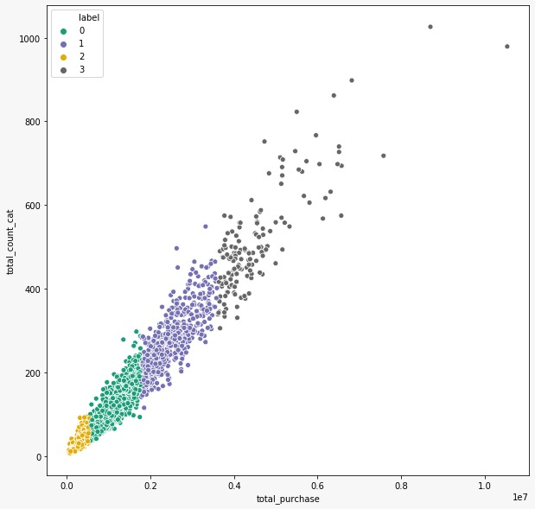
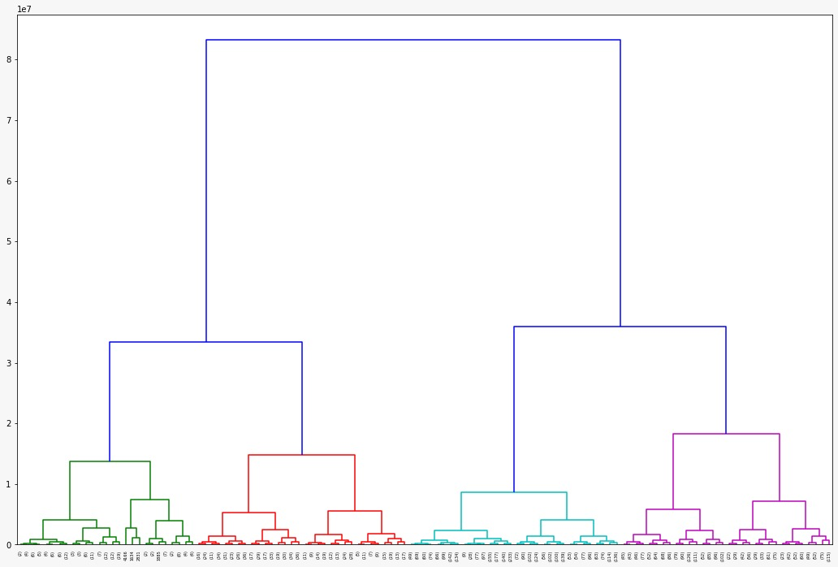
Final Model based on clusters on purchase
Elbow Plot
Scatter Plot
After reframing the data, we got 4 distinct clusters as we can see from the scatter plot and agglomerative clustering.
Agglomerative Clustering

Slide 12
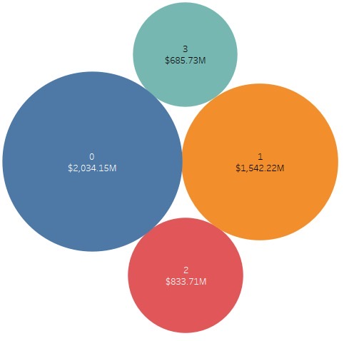
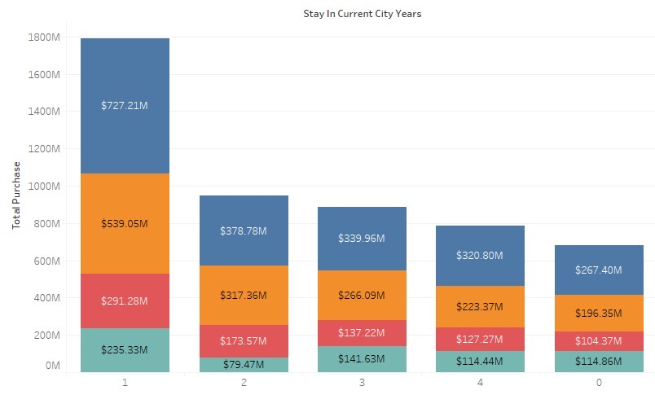

Insights from the final clustering
The most revenue has been generated from Cluster 0
In every cluster we can see that people who have stayed for one year in the current city have spent more during the sale.

Slide 13
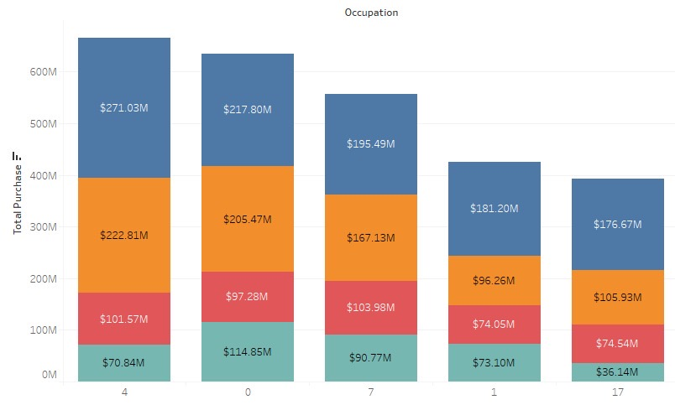
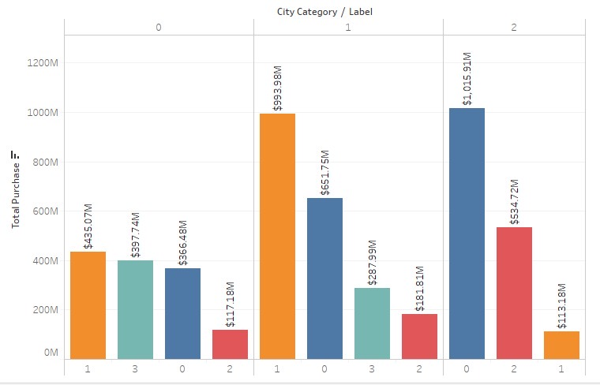
Top 5 occupations who made more purchases
Purchase patterns in different cities with respect to clusters.

Slide 14
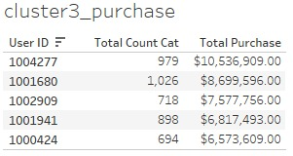
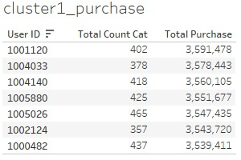
Final Inference
Cluster 3 users may be wholesale or premium buyers as the purchase quantity and total purchase are high.
Cluster 1 users may be compulsive shoppers who shop at any time irrespective of sales.

Slide 15
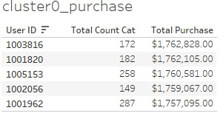
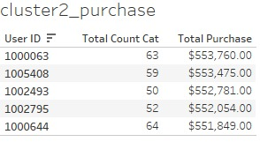
Cluster 0 users may be sales addicts who shop moderately.
Cluster 2 users might be hunters who particularly buy specific products in a single quantity as their quantity and total purchase are low.

Slide 16
THANK YOU!

